Slide 1
PYTHON – Conditions and Loops Srinivasa Bharath Kanta

Slide 2
Agenda
Conditional statements – What? Why? Where?
Loop Statements – What? Why? Where?

Slide 3
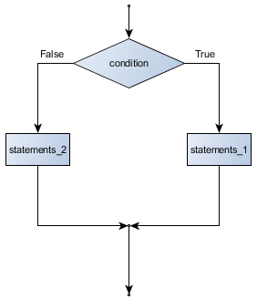
Conditional Statement
To validate a condition:
If Statement
If else statement
Chained conditions
Nested Conditions
Arrays of object references

Slide 4
If and if else
If
if x == y:
print(‘x and y are equal')
print(‘blah blah blah')
print(‘something’)
elif x<y:
print(‘x is lesser than y’)
elif x>y:
print(‘x is grater than y’)
If else
if x == y:
print(‘x and y are equal')
else:
print(‘x and y are not equal’
No Switch and case statements in python

Slide 5
Chained and nested
Chained if
if x < y:
print(‘x is lesser than y')
elif x>y:
print(‘x is greater than y ')
else:
print(‘x is equal to y’)
Nested if
if x < y:
print(‘x is lesser than y')
else:
if x>y:
print(‘x is greater than y ')
else:
print(‘x is equal to y’)

Slide 6
Loops
Iterative/Repetitive tasks
For statement
While Statement
Each item is assigned to loop variable one by one when body of the loop is executed

Slide 7
For loop
Used for definite iterations
for friend in ['Margot', 'Kathryn', 'Prisila']:
invitation = "Hi " + friend + ". Please come to my party on Saturday!"
print(invitation)
for i in range(5):
print('i is now:', i)

Slide 8
While loop
Used for indefinite iterations
number = 0
prompt = "What is the meaning of life, the universe, and everything? "
while number != "42":
number = input(prompt)
file = open('test.txt')
while True:
line = file.readline()
if not line: break
print(line)

Slide 9
Continue and break
keywords used to control the program flow and exit the indefinite loops
Break is used to exit immediately the body of the loop
for i in [12, 16, 17, 24, 29]:
if i % 2 == 1: # if the number is odd
break # immediately exit the loop
print(i)
Continue is used to skip and go to the next iteration of the loop
for i in [12, 16, 17, 24, 29, 30]:
if i % 2 == 1: # if the number is odd
continue # don't process it
print(i)

Slide 10
Thank you

